Slide 1

API-first! Contract-first! Make API development great again! v2.0
2023
Atanas L. Kuzmanov
Senior Software Engineer
Notes:
Hi everyone and welcome to my talk about API contracts, API contracts validation and testing and API development.

Slide 2

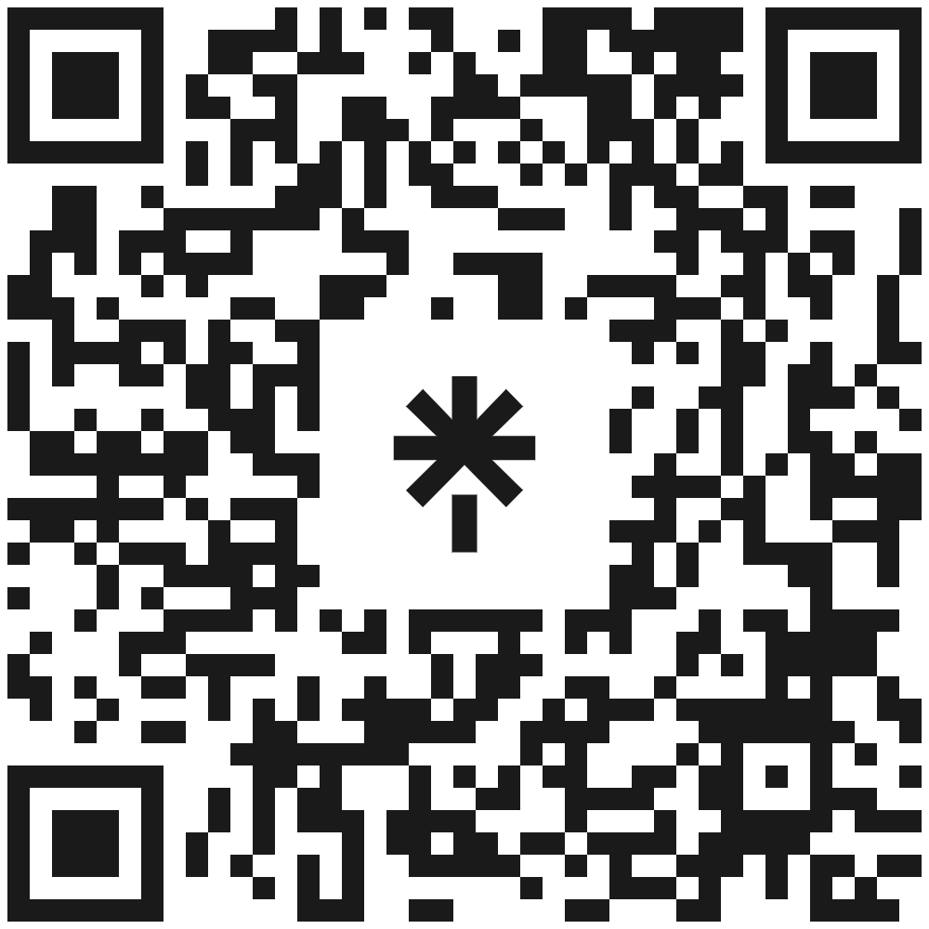



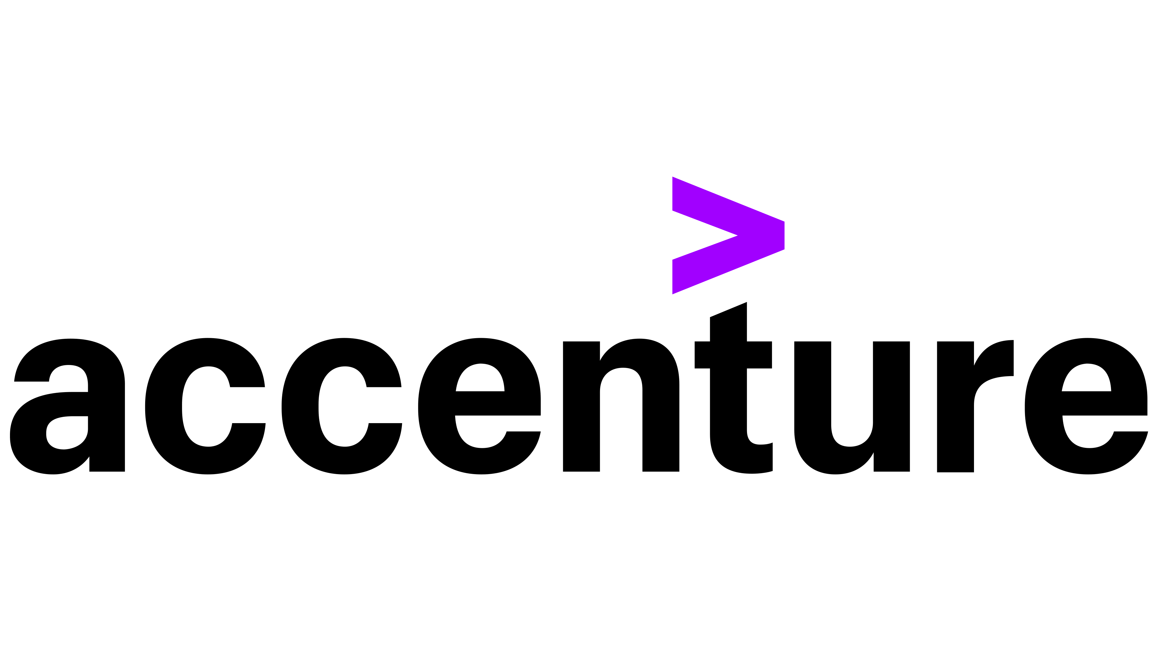
Hello, my name is
Atanas L. Kuzmanov
Senior Software Engineer
IT Solution Development
SchwarzIT Bulgaria
Background:
Where do you work?
What do you do there?
Why are you talking about this topic?
Why are you giving this talk today?
About me:
{
}
Previously:
Currently:
https://github.com/atkuzmanov
https://www.linkedin.com/in/atkuzmanov/
https://twitter.com/atkuzmanov
https://linktr.ee/atkuzmanov https://atkuzmanov.wordpress.com/
Notes:
Hi, my name is Atanas
I am a Senior Software Engineer at SchwarzIT Bulgaria
I work in the IT Solution Development Department.
I am part of the team which develops and maintains our custom CMS systems among other systems.
- Why are you talking about this topic?
My colleagues gave me a new task, I guess as a bit of a challenge – me being unaware it being something they were unable to solve a couple of years ago.
And for a good reason, the technology wasn’t quite there yet, but after a lot of hard work I was able to solve it. The task was to come up with a way to use contract testing for our APIs without having to write a whole new suit for testing or something similar.
- Why are you giving this talk today?
At the time, to the best of my knowledge, it was very few other companies, using this technology in this particular way, mainly Atlassian, us at SchwarzIT and a few others. It's only recently that I have seen the trend of this technology raising.
And still there are not enough blog posts or tutorials on this topic, so, I want to share my real-world findings with you as I think they are innovative, applicable in practice and greatly beneficial.

Slide 3
Agenda
INTRODUCTION
DESIGN FIRST VS. CODE FIRST
CODE FIRST
DESIGN FIRST APPROACH OR API FIRST APPROACH
YOUR API IS YOUR CONTRACT
CONTRACT TESTING AND VALIDATION
TOOLING
DEMO Part 1
CLASH OF THE TITANS - Spring REST and JAX-RS
DEMO Part 2
CONCLUSIONS
CLOSING THOUGHTS
REFERENCES
QUESTIONS
Notes:
A quick look at the agenda:
We will cover some basics.
We will then see Design First vs. Code First.
We will see what is an API contract and why API First is important.
We will go over the tools needed for contract testing.
And we will look at some practical applications with some Demos and draw conclusions in the end.

Slide 4
INTRODUCTION
Notes:
INTRODUCTION

Slide 5


I TURN IPA
INTO {API}
Notes:
If you came for the IPAs you are in the right place, but wrong time.
APIs now, IPAs later.

Slide 6

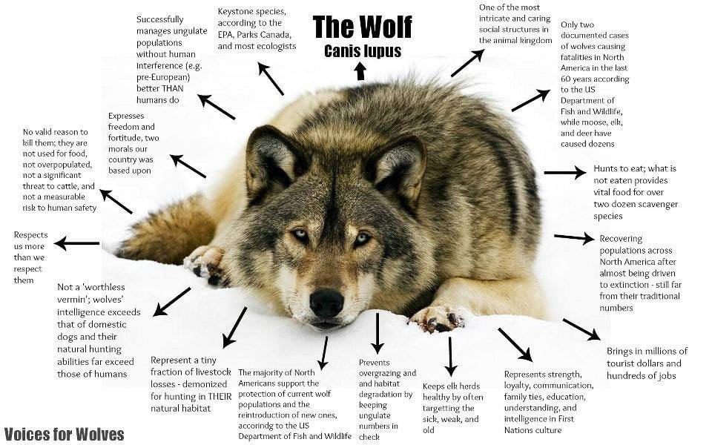

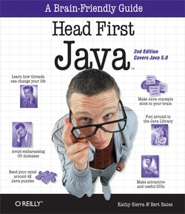

SIDE NOTE
https://www.euronatur.org/en/what-we-do/endangered-species/wolf/wolves-in-europe/
Notes:
First a small disclosure.
I will be using the following presenting technique I learned from the Head First books to keep your brains focused.
I will randomly show you slides with wolf facts and photos throughout the presentation.
This is a brain focus technique to give your brains a bit of a breather and then to bring your focus right back in.
The wolf is a noble creature and is driven to extinction in many parts of the world.
And I personally have done a donation to the Euronatur charity as one of its doings is protecting wolves in Europe.
When I donate to charities I tend not to stick to just any particular one, and since I am using wolves in this presentation I chose this one. And I have donated each time I have presented a version of this talk.
Let’s get started.

Slide 7





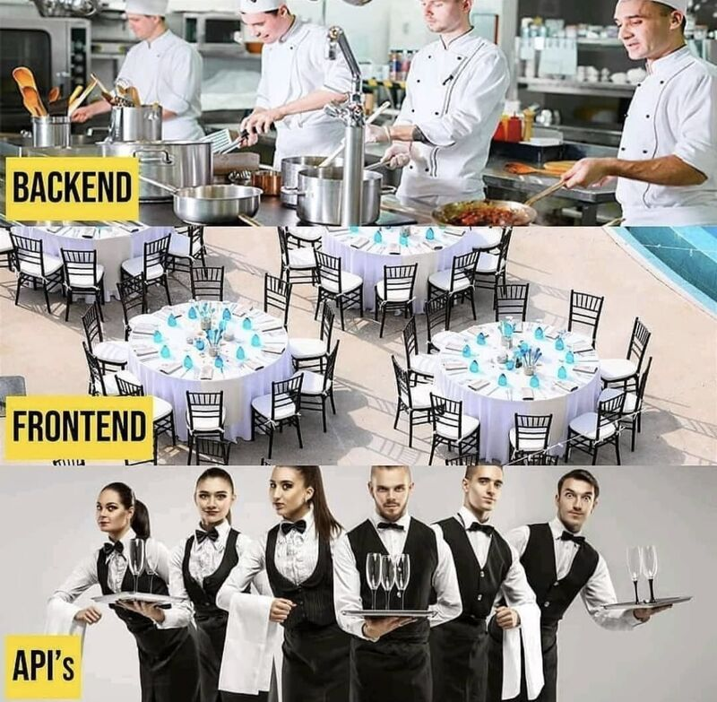

API
https://youtu.be/yqrZMEraAJ8
https://youtu.be/FW-m_j4yINU
https://youtu.be/t_mjnH-vOaQ
Notes:
For an introduction to the basics of APIs please see some of the previous versions of this talk available in those links.
This version is a follow up and therefore a more advanced one.
To get the basic idea you can always think of the familiar restaurant example.
The backend server is the kitchen, the frontend is the restaurant which you use as a client, and the waiters are the APIs which take your request to the kitchen and then bring back your response which is your food.

Slide 8
DESIGN FIRST VS. CODE FIRST
Notes:
When building software there are several approaches you can take.
So, let‘s discuss Design First vs. Code First
There are pros and cons with both, and in the end, choosing the right approach boils down to your immediate technological and strategic needs.

Slide 9
CODE FIRST
Notes:
Code First

Slide 10
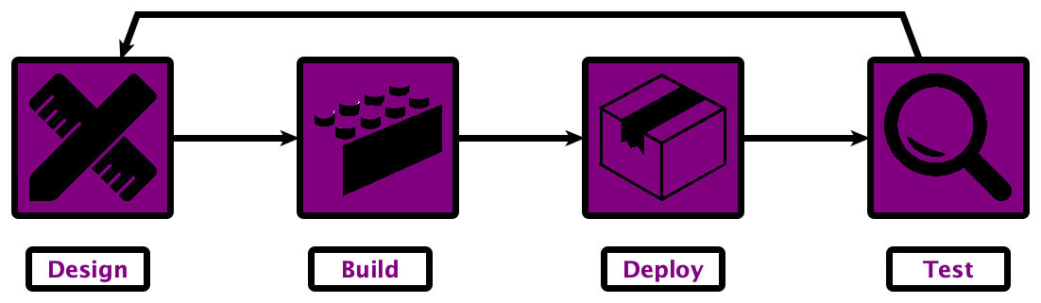
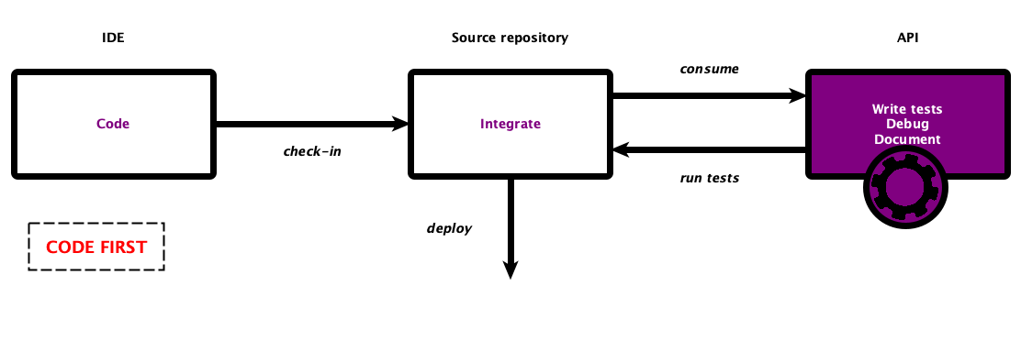
WHEN THE CODE COMES FIRST
{Code}
Notes:
With a code-first approach, you start with programming the implementation first.
This is a synchronous flow, usually used in the traditional waterfall software development.
Delays at any point in time will push back the overall delivery of the product.
Feedback is gathered later, so changes are costly since time and resources have already been invested in the product.

Slide 11

CHALLENGES OF THE
CODE FIRST APPROACH
Code First doesn't mean leaving out the design.
Rather it means the design is hidden away in Jira tickets, Confluence pages, text documents… napkins… and potentially lost to history…
This can lead to several problems.
Frustrated Users
Building the Wrong API
Missed Opportunities
Notes:
Lets look at some negatives of the Code First approach.
Code First doesn't mean leaving out the design.
Rather it means the design is hidden away in Jira tickets, Confluence pages, text documents… napkins… and potentially lost to history…
This can lead to several problems.
Frustrated Users
Building the Wrong API
Missed Opportunities

Slide 12

BENEFITS OF THE
CODE FIRST APPROACH
When Delivery Speed Matters - Developers can start coding directly from the requirements.
When Developing Internal APIs - If the API will only be consumed by the team or company that’s building it, and is small, then the Code First approach is an ideal solution.
Notes:
And now lets look at some good use cases of the Code First approach.
When Delivery Speed Matters - Developers can start coding directly from the requirements.
When Developing Internal APIs - If the API will only be consumed by the team or company that’s building it, and is small, then the Code First approach is an ideal solution.

Slide 13
DESIGN FIRST APPROACH OR API FIRST APPROACH
Notes:
DESIGN FIRST APPROACH or API FIRST APPROACH

Slide 14
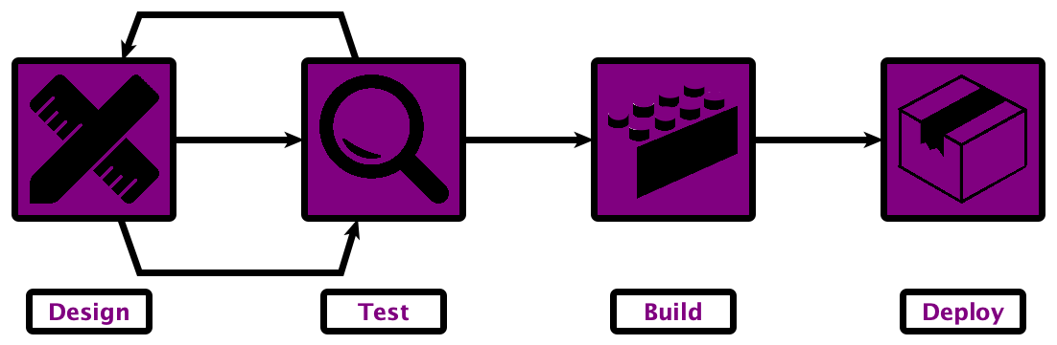
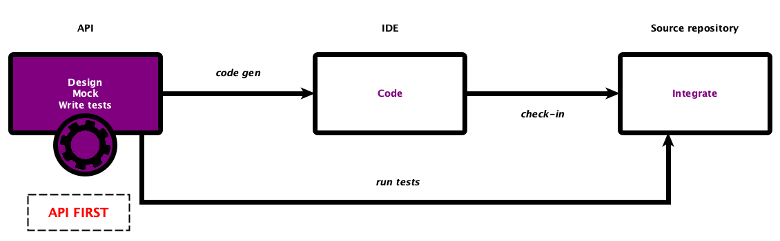
WHEN THE API COMES FIRST
{API}
Notes:
In comparison in the Design first approach when starting with the API, instead of writing code, you do, planning the API, mocks, and tests of the API.
This process is aligned with agile software development.
It allows the team and any stakeholders, technical and non-technical, to weigh in on the design and functionality, early and often, before a lot of time and effort is sunk into the project.
Once the direction has been solidified, the design then serves as the contract that all teams can begin working towards in parallel.

Slide 15

CHALLENGES OF THE DESIGN FIRST APPROACH
It’s hard work - To be honest, it takes a lot of hard work for any team to move to a Design First approach.
It takes commitment - Companies must be intentional no matter their size - this shift to API First doesn’t happen on its own and it doesn’t happen overnight.
Notes:
And now first for some negatives of the Design First approach.
It’s hard work - To be honest, it takes a lot of hard work for any team to move to a Design First approach.
It takes commitment - Companies must be intentional no matter their size - this shift to API First doesn’t happen on its own and it doesn’t happen overnight.

Slide 16
WHY API FIRST?
BENEFITS OF DESIGN FIRST
The API First approach gives us the following main advantages:
It allows early feedback from stakeholders with fast turnaround cycles.
It happens at a stage when changes are easily doable, before a lot of time and effort are sunk into the project.
It leads to Product-Driven APIs with better user experience and higher customer satisfaction.
It reduces coupling and enables provider and consumer teams to work independently and in parallel.
The API definition can be the Single Source of Truth for Developers, DevOps and Architects.
Notes:
Now let’s look at the benefits of the Design First approach which far outweigh the challenges.
It allows early feedback from stakeholders with fast turnaround cycles.
It happens at a stage when changes are easily doable, before a lot of time and effort are sunk into the project.
It leads to Product-Driven APIs with better user experience and higher customer satisfaction.
It reduces coupling and enables provider and consumer teams to work independently and in parallel.
The API definition can be the Single Source of Truth for Developers, DevOps and Architects.

Slide 17


REAL WORLD EXAMPLES
{API}
Notes:
A couple of real world examples.
Speaking from personal experience from working at the BBC and at Schwarz IT:
We use API-first design and we have seen some great benefits including reduced development times, tighter feedback loops, and better API design overall.

Slide 18

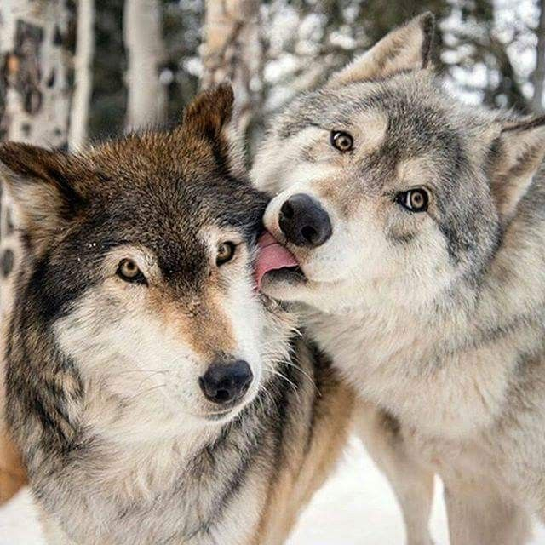

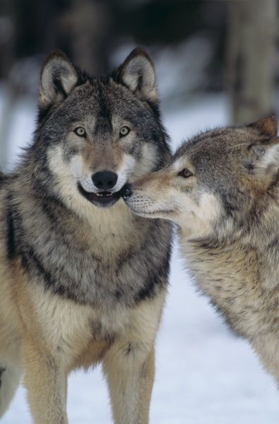
WOLF FACT
True love
Once a wolf has found a mate, they tend to stay together for better or worse, through sickness and health, often until death due them part.
They have been known to sacrifice themselves for the survival of other wolves.
So, move over Romeo and Juliet!
Notes:
Random wolf fact.
True love
Once a wolf has found a mate, they tend to stay together for better or worse, through sickness and health, often until death due them part.
They have been known to sacrifice themselves for the survival of other wolves.
So, move over Romeo and Juliet there is a new couple in town!

Slide 19
YOUR API IS YOUR CONTRACT
Notes:
YOUR API IS YOUR CONTRACT

Slide 20
WHAT IS AN API CONTRACT?
API First means that implementation starts with the definition of an API.
The API defines the contract for providers and consumers to rely on, i.e. the interface is clearly defined.
The contract uses tools such as OpenAPI to describe the requests and responses of each API.
It is something that both API provider and consumer agree on, and get to work on delivering and consuming - for an agreed upon price.
An API contract helps communicates change.
Providing an OpenAPI spec before each new version allows consumers to review the contract before they commit to it.
Notes:
WHAT IS AN API CONTRACT?
API First means that implementation starts with the definition of an API.
The API defines the contract for providers and consumers to rely on, i.e. the interface is clearly defined.
The contract uses tools such as OpenAPI to describe the requests and responses of each API.
It is something that both API provider and consumer agree on, and get to work on delivering and consuming - for an agreed upon price.
An API contract helps communicates change.
Providing an OpenAPI spec before each new version allows consumers to review the contract before they commit to it.
All of these things help with your API economy.
An API Economy is more or less, generally the practice of exchanging data and value between consumers and providers through HTTP-based APIs such as REST APIs.

Slide 21

WHAT IS AN API CONTRACT?
This sounds great and all, but if there is no way to enforce a contract, people might not keep it?
This can have disastrous consequences.
If only there was a way to change this?!?
Notes:
This sounds great and all, but if there is no way to enforce a contract, people might not keep it?
This can have disastrous consequences.
If only there was a way to change this?!?

Slide 22
CONTRACT TESTING AND VALIDATION
Notes:
Enter Contract Testing and validation!

Slide 23
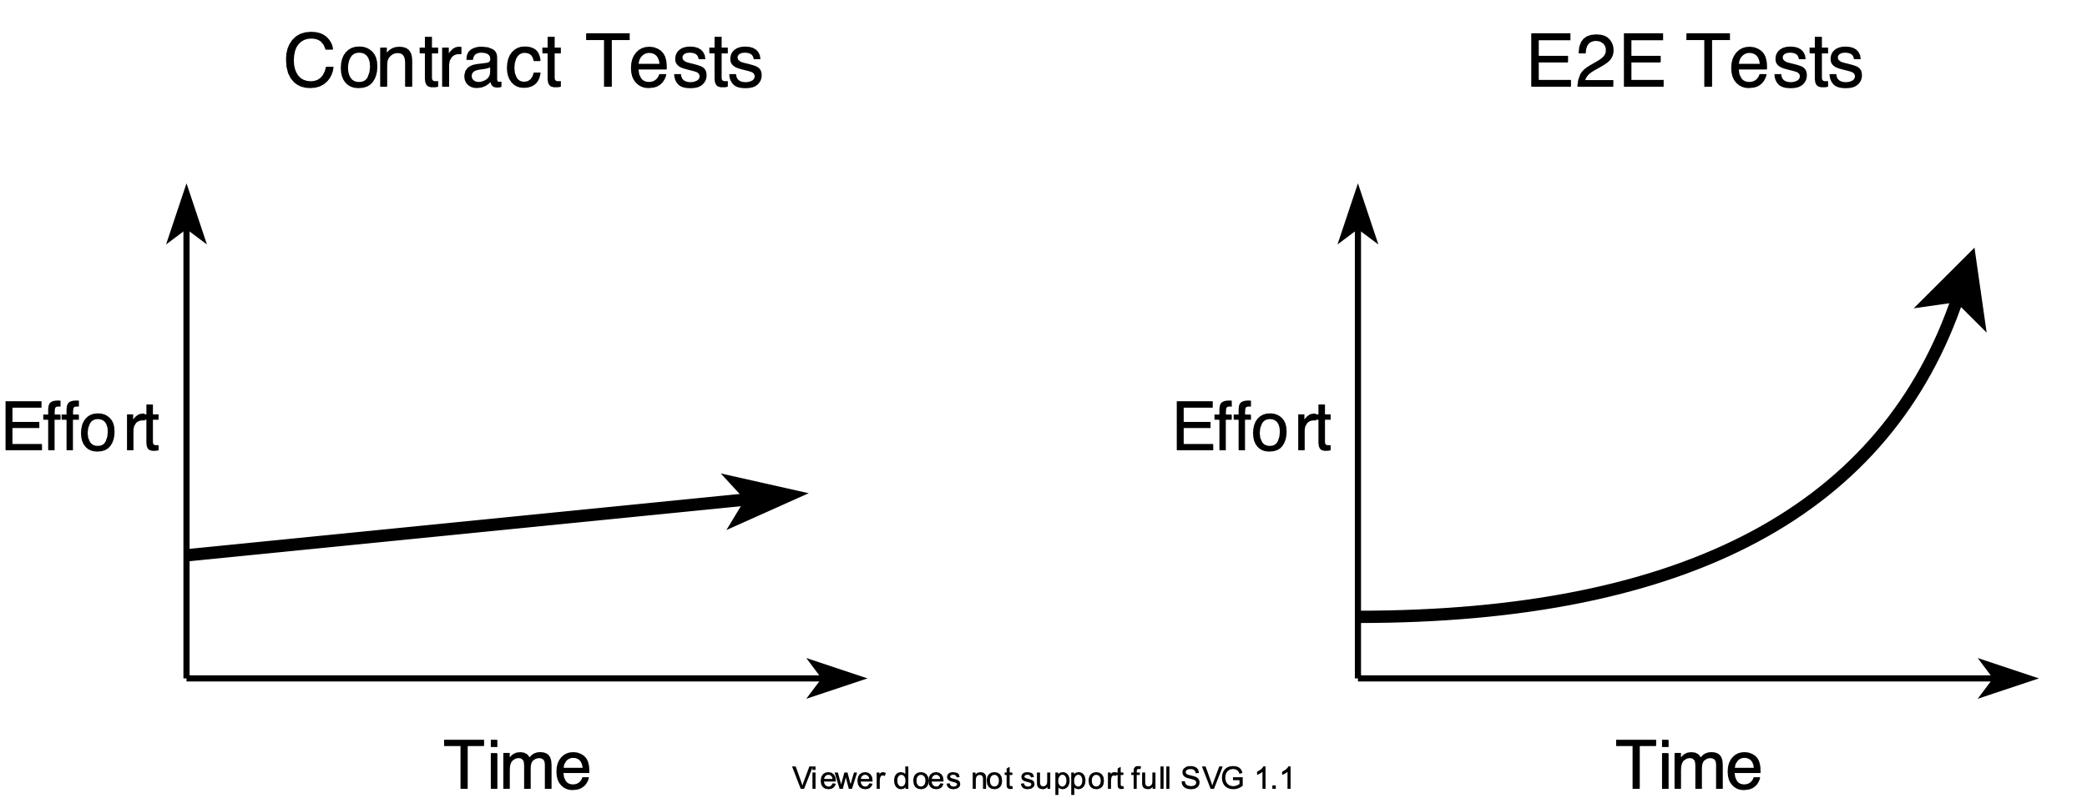
WHAT IS THIS
CONTRACT TESTING THING?
This is the way we enforce and validate our contracts.
When compared to E2E testing, contract testing enables you to create consistent curves in your pipeline’s speed and complexity that look more like the chart below.
And still maintain many of the safety guarantees of E2E tests.
Notes:
WHAT IS THIS CONTRACT TESTING THING?
This is the way we enforce and validate our API contracts.
When compared to E2E testing, contract testing enables you to create consistent curves in your pipeline’s speed and complexity that look more like the chart below.
And still maintain many of the safety guarantees of E2E tests.

Slide 24
CONVINCE ME
The main thing that any organisation cares about when it comes to software development is cost.
When building a product, your time is probably the biggest cost to an organisation.
There will be initial overhead in learning how to use and integrate contract tests in your pipelines.
Using contract tests in conjunction with, or as a replacement for traditional end-to-end tests will be cheaper in the long run.
Notes:
So, how do I convince you?
The main thing that any organisation cares about when it comes to software development is cost.
When building a product, your time is probably the biggest cost to an organisation.
There will be initial overhead in learning how to use contract tests and integrating them into your build pipeline.
Using contract tests in conjunction with, or as a replacement for traditional end-to-end tests will be cheaper in the long run.

Slide 25
TOOLING
Notes:
We are going to need the right tools for the job.

Slide 26

OPENAPI SPEC ANATOMY
openapi: "3.0.0"
info:
version: 1.0.0
title: Swagger Petstore
license:
name: MIT
servers:
- url: http://petstore.swagger.io/v1
paths:
/pets:
get:
summary: List all pets
operationId: listPets
tags:
- pets
parameters:
- name: limit
in: query
description: How many items to return at one time (max 100)
required: false
schema:
type: integer
format: int32
responses:
'200':
description: A paged array of pets
headers:
x-next:
description: A link to the next page of responses
schema:
type: string
content:
application/json:
schema:
$ref: "#/components/schemas/Pets"
default:
description: unexpected error
content:
application/json:
schema:
$ref: "#/components/schemas/Error"
Main body YAML
Schemas YAML
components:
schemas:
Pet:
type: object
required:
- id
- name
properties:
id:
type: integer
format: int64
name:
type: string
tag:
type: string
Notes:
First let’s look at the the anatomy of an OpenAPI spec document written in YAML.
It defines a standard format, and a language-agnostic interface to REST APIs.
You can see:
- Available endpoints and operations on each endpoint (GET /example, POST /example).
- Parameters.
- Authentication methods.
- Contact information, license, terms of use etc.
Can be also written in JSON.
It also has schemas for modelling objects.

Slide 27

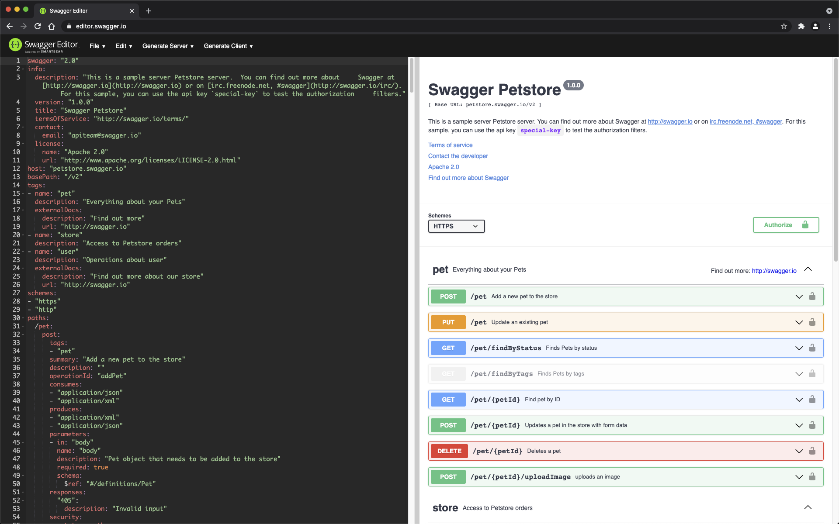
SWAGGER
“Code-first and meh docs later…“
We will write docs ”when we have time”… almost definitely for sure… maybe…“
Notes:
Our next tool is Swagger.
Swagger is a set of open-source tools built around the OpenAPI Specification.
Once you have an spec file, with Swagger you can generate a server stub, and the only thing left to do will be to implement the logic, and then your API is ready to go!
You can generate interactive documentation that lets you try out the API directly in the browser.
And also when it comes to documentation, do any of these look or sound familiar?
“Code-first and meh docs later…“
We will write docs ”when we have time”… almost definitely for sure… maybe…“
With swagger you have the documentation right from the beginning.

Slide 28

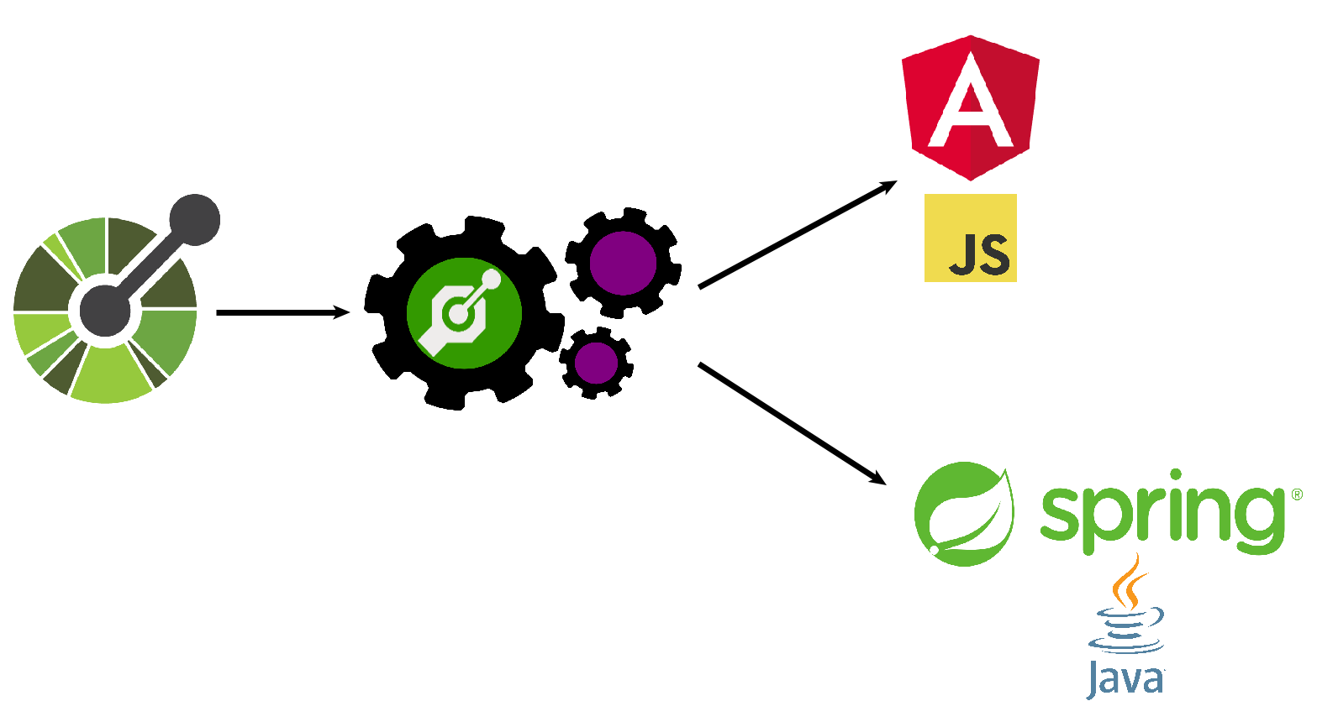
OPENAPI GENERATOR:
SPEC-TO-CODE GENERATION
Given an OpenAPI Spec, and using an OpenAPI Generator you can generate:
API clients.
Server stubs.
Documentation.
Etc.
Notes:
The next tool we need is an OpenAPI generator.
Given an OpenAPI Spec, and using an OpenAPI Generator you can generate:
API clients.
Server stubs.
Documentation.
And etcetera etc.
This is often called “spec-to-code generation”, because you use an OpenAPI spec file, and an OpenAPI generator, to generate code from the spec file.
We will see this a bit later in the demo.

Slide 29
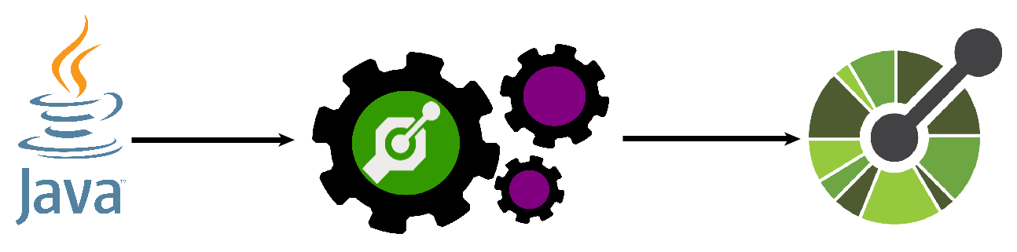
OPENAPI GENERATOR:
CODE-TO-SPEC GENERATION
Given an existing code base, and using an OpenAPI Generator, generate an OpenAPI Spec.
Notes:
Here is the reverse of the previous slide – “code-to-spec generation”.
This is where you use an existing code base, and an OpenAPI Generator, to generate OpenAPI Spec files for it, for documentation for example.

Slide 30
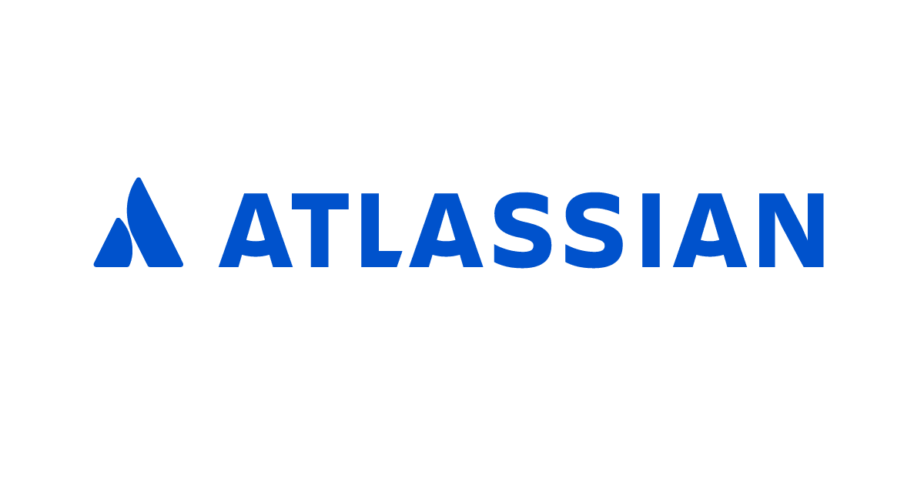
ATLASSIAN
OPENAPI VALIDATOR
After spending a bit of time researching how can I do request and response validation for our existing APIs, without having to write a library to do the work, I found the answer!
Atlassian – Request Validator
A Java library for validating HTTP request/responses against an OpenAPI specification.
It has several modules for different frameworks including integrations with the REST Assured testing library.
Notes:
Here is an extremely important component we need.
After spending a bit of time researching how can I do request and response validation for our existing APIs, without having to write a complicated parser or library to do the work, I found the answer!
Atlassian – Request Validator
A Java library for validating HTTP request/responses against an OpenAPI specification.
It has several modules for different frameworks including integrations with the REST Assured testing library.

Slide 31

FRONTEND OPENAPI VALIDATOR
And here are a couple of OpenApi validators for the frontend, using ExpressJS, which automatically validate API requests and responses based on an OpenAPI spec.
express-openapi-validate (https://www.npmjs.com/package/express-openapi-validate)
express-openapi-validator (https://www.npmjs.com/package/express-openapi-validator)
Notes:
And here are a couple of OpenApi validators for the frontend, using ExpressJS, which automatically validate API requests and responses based on an OpenAPI spec.
express-openapi-validate (https://www.npmjs.com/package/express-openapi-validate)
express-openapi-validator (https://www.npmjs.com/package/express-openapi-validator)

Slide 32








OTHER TOOLS
Java
SpringBoot
JavaScript
TypeScript
Angular
MongoDB
Docker
Notes:
And all the usual suspects for the demo.

Slide 33

WOLF FACT
The Wolf /Canis Lupus/
Represents strength, loyalty, family ties, caring and expresses freedom and fortitude.
The Japanese word for wolf, "Ookami", means "Great God".
Notes:
Random wolf fact.
The wolf represents strength, loyalty, family ties, caring and expresses freedom and fortitude.
The Japanese word for wolf, "Ookami", means "Great God".
So, a pretty cool animal overall.

Slide 34
DEMO Part 1
Notes:
DEMO

Slide 35
DEMO PART 1 TODO
Look at an OpenAPI Spec.
Use it and an openapi-generator to generate a back-end server in Java and SpringBoot.
Use it and an openapi-generator to generate a front-end client in JavaScript and Angular.
Use Atlassian’s validator to add tests to the back-end server and validate our API.
Use express-openapi-validate to add tests to the front-end server and validate our API.
Demonstrate how the tests fail if we breach our API contract.
Notes:
Let’s have a look at what are we going to do in the demo.
Look at an OpenAPI Spec.
Use it to generate a back-end server in Java and SpringBoot.
Use it to generate a front-end client in JavaScript and Angular.
Use Atlassian’s validator to add tests to the back-end server and validate our API.
Use express-openapi-validate to add tests to the front-end server and validate our API.
Demonstrate how the tests fail if we breach our API contract.

Slide 36
{DEMO}
Notes:
DEMO

Slide 37


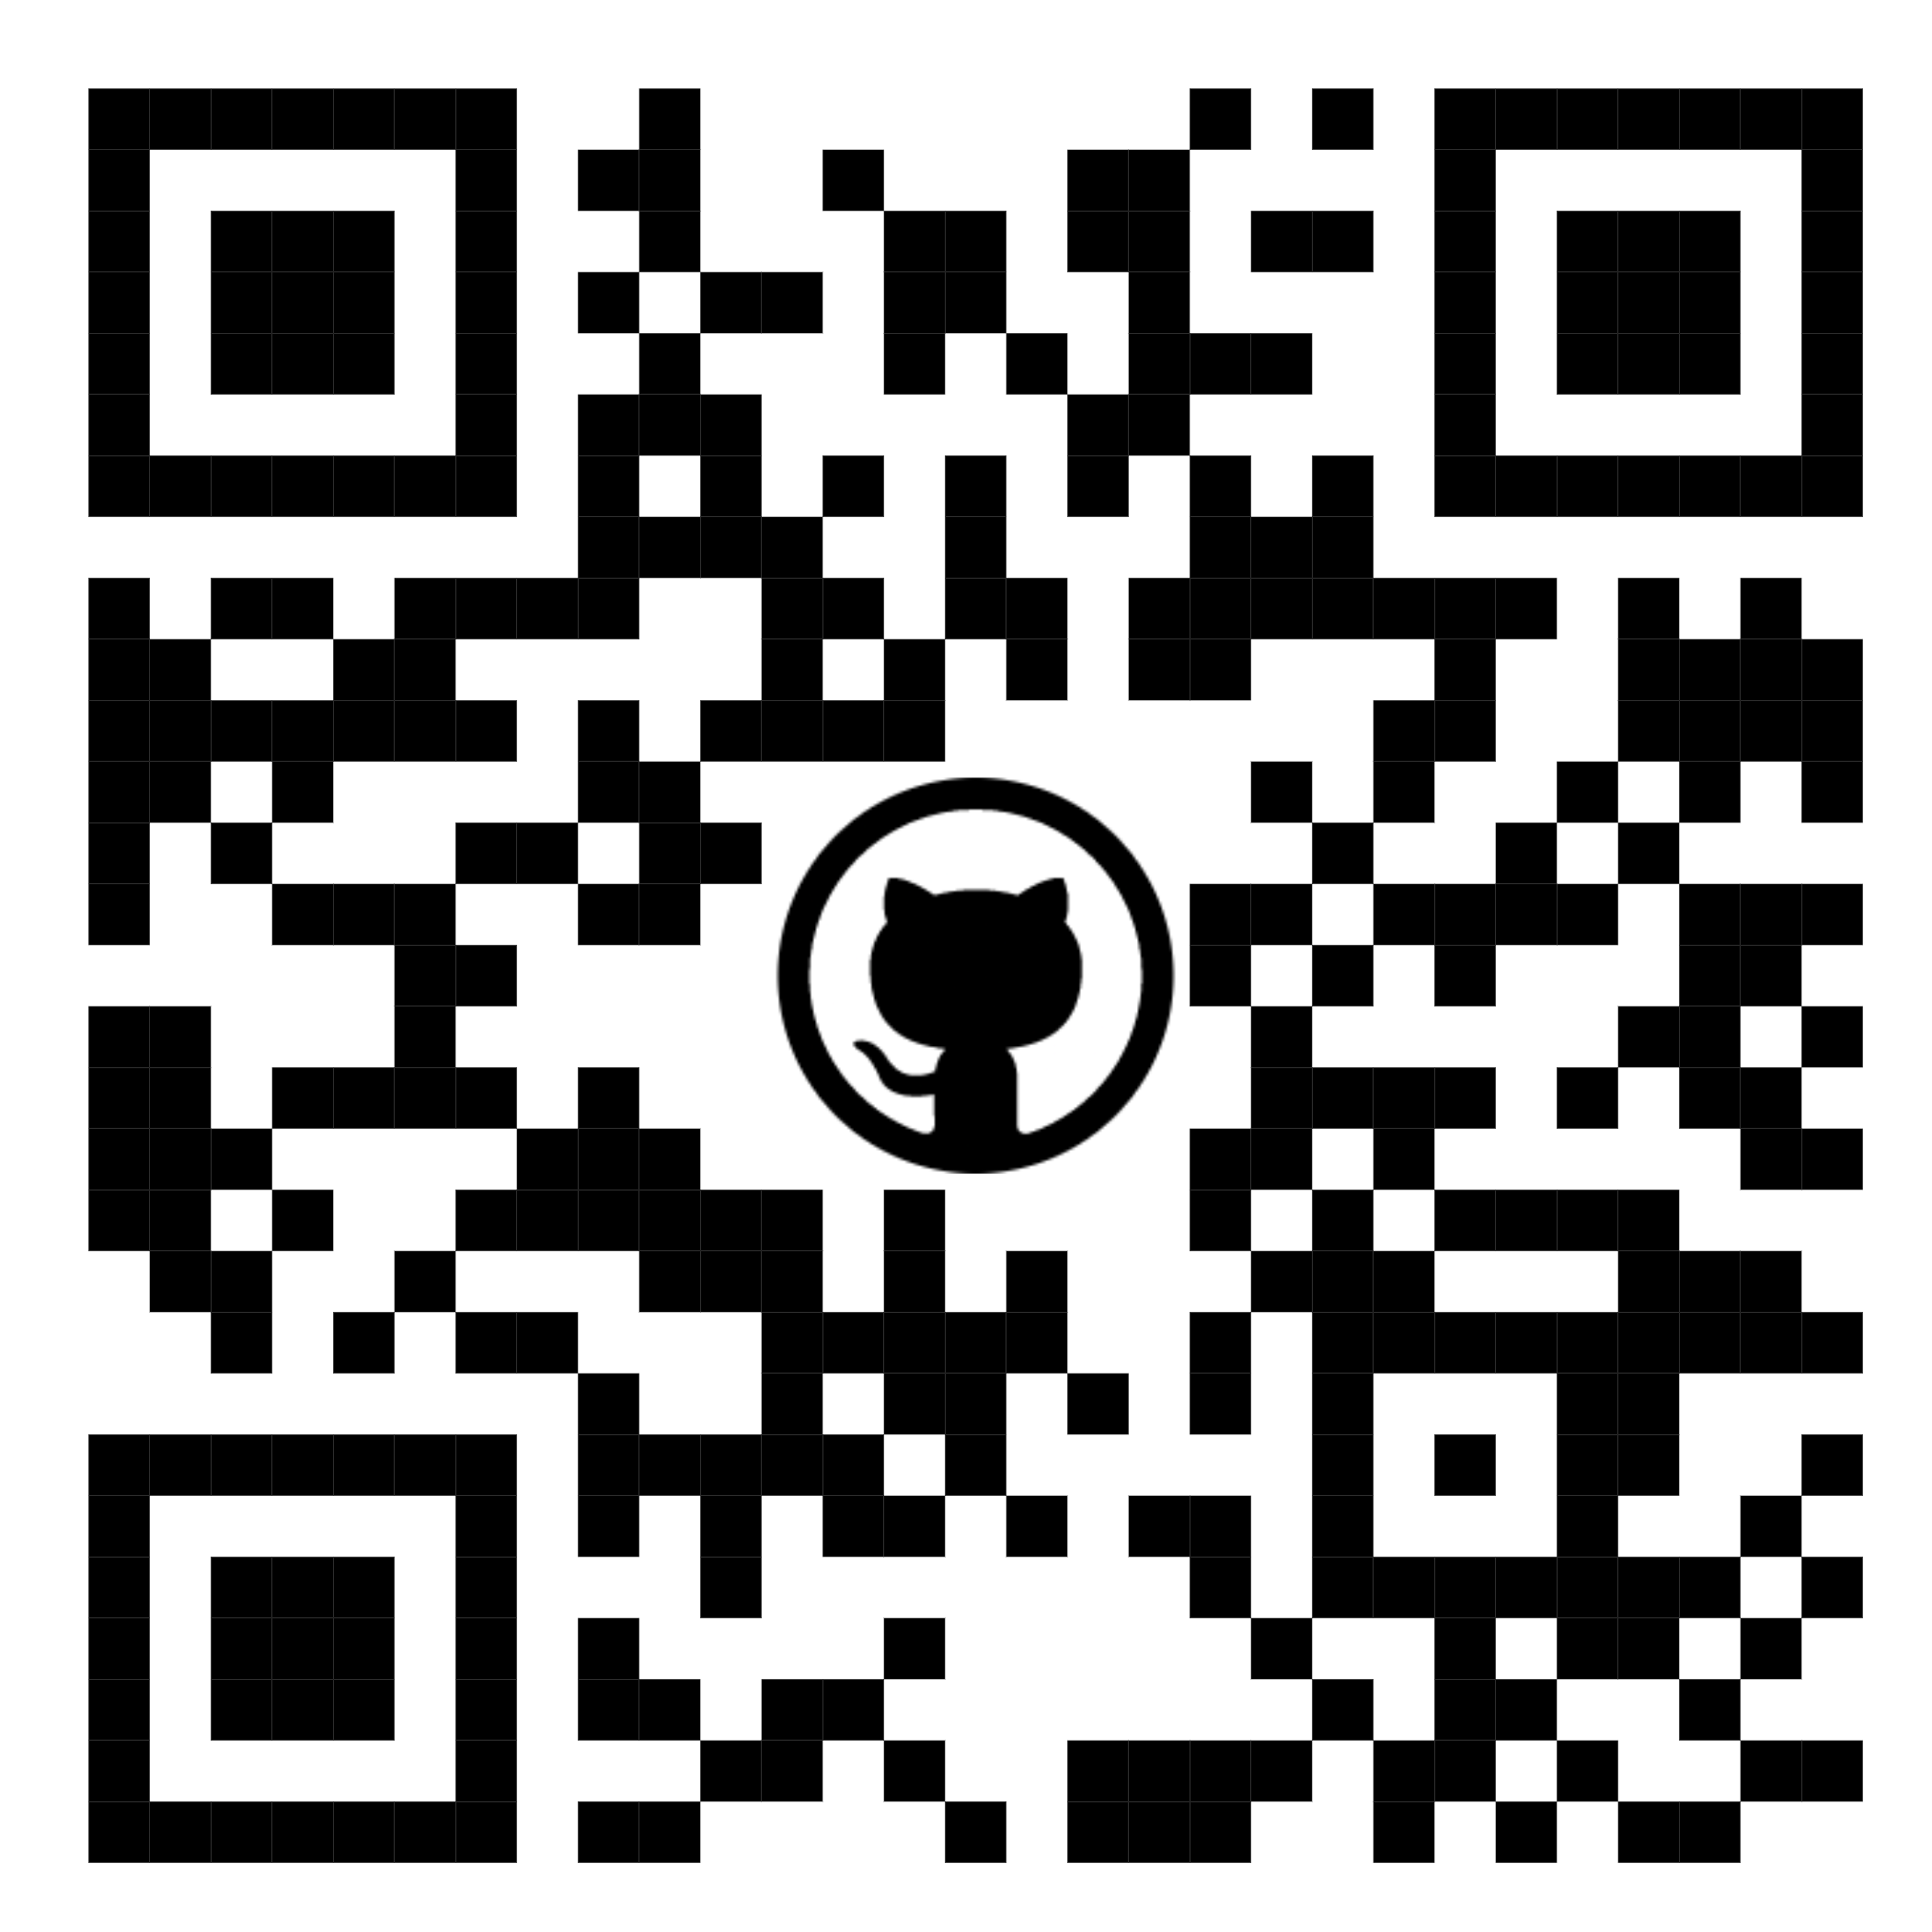
{DEMO RECAP}
Contract Validation Demo links:
Demo Video Part 1:
https://www.youtube.com/watch?v=KGgqdpDWh0I
https://youtu.be/KGgqdpDWh0I
Demo Video Part 2:
https://www.youtube.com/watch?v=0AvPftcZvWY
https://youtu.be/0AvPftcZvWY
Demo GitHub Repo:
https://github.com/atkuzmanov/openapi-demo-2022
Disclosure: I bear no responsibility for the videos and code, or maintaining them, they come with no guarantees, warrantees etc. use at your own risk.
Notes:
While we do a little recap of what we achieved you can checkout the links or QR codes for videos of the demo and some demo code in GitHub.
So, let's go over what we achieved in the demo:
Looked at an OpenAPI Spec file - It’s easy, both human and machine readable.
Used it and to generate a back-end server in Java and SpringBoot - This saves development time.
Used it to generate a front-end client in JavaScript and Angular - This also saves development time.
Used Atlassian’s validator to add tests to the back-end server and validate our API - This gives us a fast feedback loop.
Used express-openapi-validate to add tests to the front-end and validate our API - This also gives us a fast feedback loop.
We demonstrated how the tests fail if we breach our API contract.
And that this is how we enforce the contract, making communication and development easier.

Slide 38
CLASH OF THE TITANS - Spring REST and JAX-RS
Notes:
CLASH OF THE TITANS - Spring REST and JAX-RS

Slide 39

CLASH OF THE TITANS: OpenAPI + Spring REST + JAX-RS
So far, so good…
Then you start adding OpenAPI in the real world, in a system which has gone through a few life-cycles and you encounter clash of the titans…
A Java service application using both Spring REST and JAX-RS in the same code base…
And you begin to try and make it work with OpenAPI for both…
Notes:
So far, so good…
Then you start adding OpenAPI in the real world, in a system which has gone through a few life-cycles and you encounter clash of the titans:
A Java service application using both Spring REST and JAX-RS in the same code base…
And you begin to try and make it work with OpenAPI for both…

Slide 40
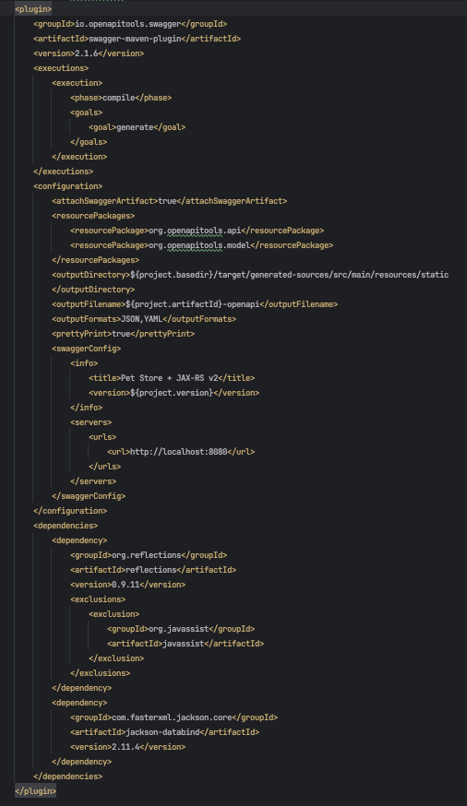
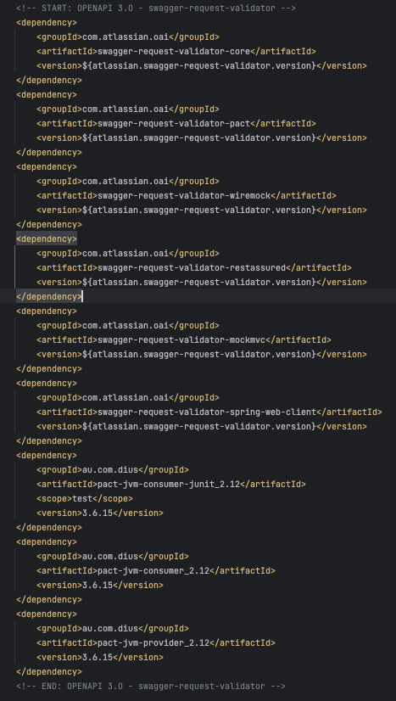
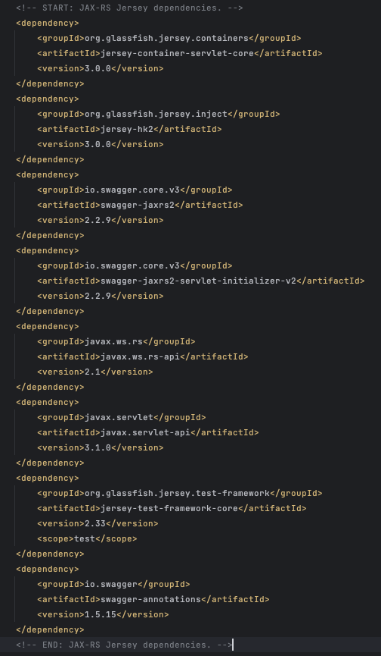
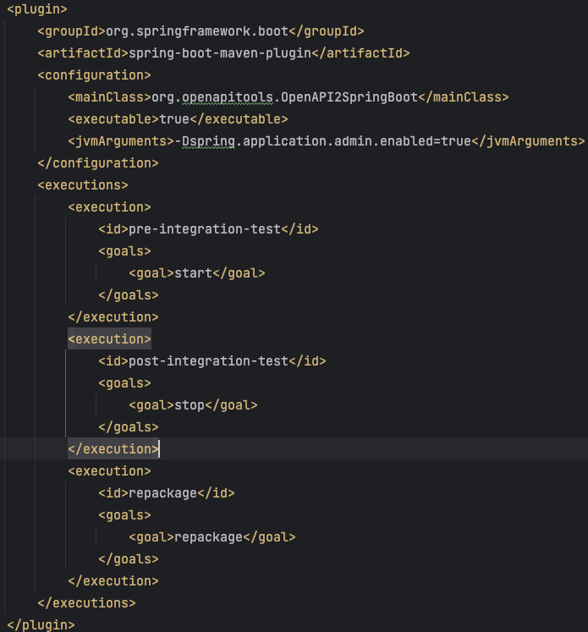
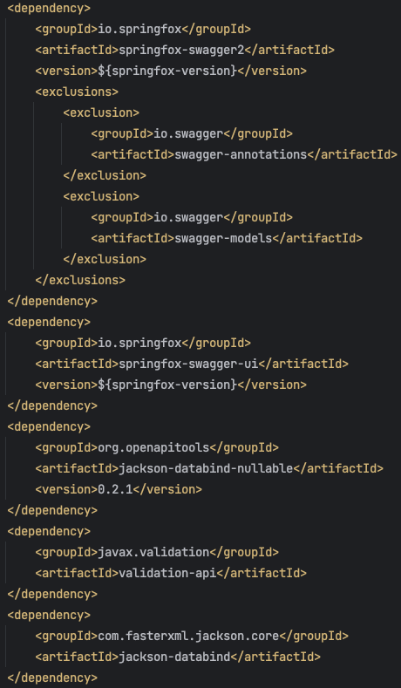
Real-world Spring REST and JAX-RS clash of the titans
Notes:
Aand you start adding and configuring the necessary plugins and dependencies.

Slide 41
OPENAPI + SPRING REST + JAXRS
pom.xml
Dependencies and plugins.
/src/main/java/com/kaufland/property/directory/config/SwaggerConfig.java
Swagger configuration.
/src/main/resources/application.yml
Springdoc/Springfox dependency configurations.
/src/main/java/com/kaufland/property/directory/controller/IndexController.java
A controller for the Swagger ui.
/src/main/resources/openapi-configuration.yaml
Config for spec generation.
/src/test/java/com/example/service/OpenApiContractValidationTests.java
Tests using Atlassian's OpenApiValidationFilter to validate the code against an OpenAPI spec file.
/src/main/java/com/example/config/JerseyConfig.java
Registering OpenApi resources for spec generation
/src/test/java/com/example/OpenAPIModifier.java
Custom OpenAPIModifer class to modify our OpenAPI spec file before the tests run.
Notes:
And then all the rest of the code, and this is still a pretty high-level veiw.
Pom file with dependencies and plugins
Application yaml with springdoc or springfox config
Openapi config
Jersey config for JAX-RS
Swagger config
A controller for the swagger ui
Validation tests using Atlassian’s OpenAPI validator
And you even need a custom OpenAPI modifier when your tests become complex.
You need it to parse your spec before the tests because the validator can really handle null mandatory fields and you need to make all of them nullable or write thousands of lines of code for mocking all of them for a single test which is not feasible.
And this is an example with a pretty basic application, imagine if you have to do this in a fairly large code-base or project.

Slide 42
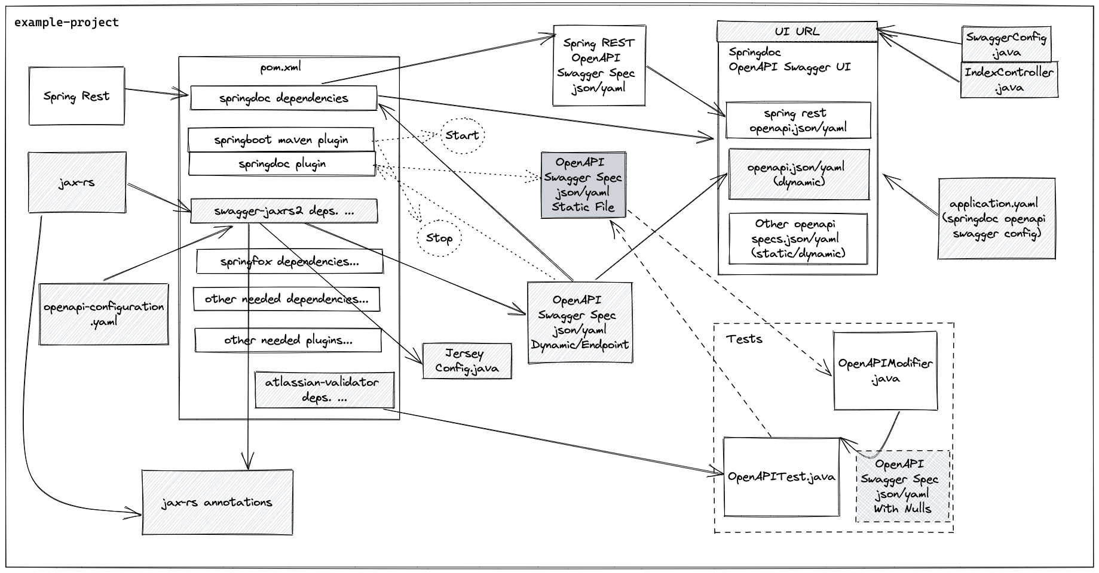
OPENAPI + SPRING REST + JAXRS
Notes:
And then you try to explain it all to your colleagues…
That you need some plugins to start and stop your service, so that some other plugins or dependencies can hit some endpoints and download an OpenAPI spec file just from the JAX-RS annotations…
And then do some more magic for the Spring REST part…
And then even more steps for validation test…
And one of the biggest problems I encountered was the fact that most of the OpenAPI tools were either with poor documentation, kind of false advertising as they did not do exactly as described, or worst of all behind Java versions, like for example supporting only up to Java 8 and we were already at Java 17.
And trying to make them work together is either not worth the effort or not possible…

Slide 43

OPENAPI + SPRING REST + JAXRS
Notes:
And this is what you look like explaining all of this…

Slide 44
DEMO part 2
Notes:
DEMO

Slide 45
DEMO PART 2 TODO
Look at a code-to-spec scenario.
Try to generate OpenAPI spec files from a Java application using both Spring REST and JAX-RS in the same code base.
Highlight some of the difficulties encountered.
Draw conclusions and lessons learned.
Notes:
Now, in part two of the demo we are going to look at a code-to-spec generation scenario.
Try to generate OpenAPI spec files from a Java application using both Spring REST and JAX-RS in the same code base.
Highlight some of the difficulties encountered.
Draw conclusions and lessons learned.

Slide 46
{DEMO}
Notes:
DEMO

Slide 47


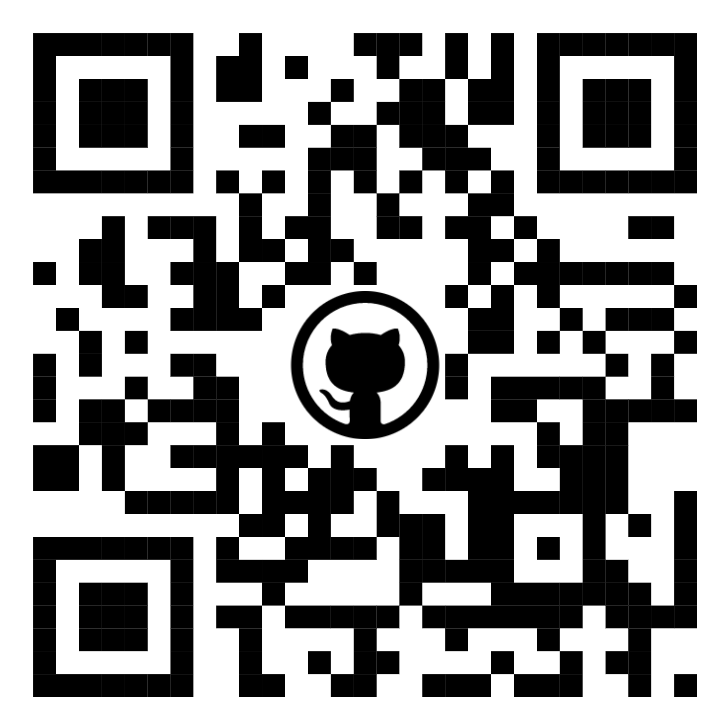
{DEMO RECAP}
OpenAPI + Spring REST + JAX-RS Demo links:
Demo 2 Video Part 1:
https://www.youtube.com/watch?v=hB93Apbj5GQ
https://youtu.be/hB93Apbj5GQ
Demo 2 Video Part 1:
https://www.youtube.com/watch?v=go_9HquFdac
https://youtu.be/go_9HquFdac
Demo 2 GitHub Repo:
https://github.com/atkuzmanov/openapi-demo-2023-publ
Disclosure: I bear no responsibility for the videos and code, or maintaining them, they come with no guarantees, warrantees etc. use at your own risk.
Notes:
While we do a little recap of what we achieved you can checkout the links or QR codes for videos of the demo and some demo code in GitHub.
We generated OpenAPI spec files from a Java application using both Spring REST and JAX-RS in the same code base.
We highlighted some of the difficulties encountered, like how difficult it is to configure and keep all technologies happy playing alongside each other.
And now we will draw some conclusions and lessons learned.

Slide 48
CONCLUSIONS
Notes:
CONCLUSIONS

Slide 49

CONCLUSIONS
Nowadays, when hybrid working is more widespread than before, having a common, simple medium of communication such as an OpenAPI spec document is indispensable in meeting your requirements when building APIs.
Things get even more exciting when this so-called document can:
Serve as a contract
Generate clients, servers, and documentation
Put your developers and client first
Have Automatic, Fail-fast, API Validation tests
Is Cross-Platform and Language Agnostic
Is both human and machine readable in YAML or JSON
Speeds up development
Reduces costs
Things we have to keep in mind:
Even when you start with API-first writing a spec file first before writing any code, and then you generate the code, you eventually end up generating the spec from the code. This happens because over time when the code base matures it grows and evolves in different ways and often manipulating the spec manually becomes difficult, tedious and time-consuming. Moving to code-to-spec generation is the natural progression of an API First project in it's lifecycle.
The OpenAPI tools are getting better, but still need more development, at least when it comes to Java.
They work for simple use cases, but become unusable for more complex scenarios.
A lot of them have vulnerabilities or compatibility issues due to lack of maintenance.
Most of them are open source, so any contributions from the community are welcome for the greater good.
Try not to mix REST standards like Spring REST and JAX-RS in the same codebase…
Notes:
Nowadays, when hybrid working is more widespread than before, having a common, simple medium of communication such as an OpenAPI spec document is indispensable in meeting your requirements when building APIs.
Things get even more exciting when this so-called document can:
Serve as a contract
Generate clients, servers, and documentation
Put your developers and client first
Have Automatic, Fail-fast, API Validation tests
Is Cross-Platform and Language Agnostic
Is both human and machine readable in YAML or JSON
Speeds up development
Reduces costs
As good as it sounds, there are a few things we have to keep in mind:
Even when you start with API-first, writing a spec file first before writing any code, and then you generate the code, you eventually end up generating the spec from the code. This happens because over time when the code base matures it grows and evolves in different ways and often manipulating the spec manually becomes difficult, tedious and time-consuming. Moving to code-to-spec generation is the natural progression of an API First project in it's lifecycle.
The OpenAPI tools are getting better, but still need more development at least when it comes to Java.
They work for simple use cases, but become unusable for more complex scenarios.
A lot of them have vulnerabilities or compatibility issues due to lack of maintenance.
Most of them are open source, so any contributions from the community are welcome for the greater good.
And Maybe Try not to mix REST standards like Spring REST and JAX-RS in the same codebase…

Slide 50
CLOSING THOUGHTS
Notes:
CLOSING THOUGHTS

Slide 51


CLOSING THOUGHTS
I would like to leave you with some lyrics from the song
“Everything Counts” by Depeche Mode:
"The handshake seals the contract
From the contract there’s no turning back
…
The holiday was fun-packed
The contract, still intact…”
References:
https://www.depechemode.de/lyrics/everything-counts-2/
https://www.youtube.com/watch?v=1t-gK-9EIq4
https://en.wikipedia.org/wiki/Everything_Counts
Notes:
I would like to leave you with some the lyrics from the song “Everything Counts“ by Depeche Mode:
"The handshake seals the contract
From the contract there’s no turning back
...
The holiday was fun-packed
The contract, still intact
…”
So, keep your contracts intact people, don’t break them!

Slide 52

“You Give REST a Bad Name”
A parody of Jon Bon Jovi’s ‘You Give Love a Bad Name’ about hypermedia APIs by Dylan Beattie.
"... Your API is a hall of shame... ”
"... You give REST a bad name... "
"... you say it works in a restful way, then your errors come back as 200 OK... "
"... you promised me JSON, then sent XML... "
https://www.youtube.com/watch?v=nSKp2StlS6s
https://youtu.be/nSKp2StlS6s?t=59
References:
https://www.youtube.com/watch?v=nSKp2StlS6s
https://www.youtube.com/channel/UCjJjavV8vOmu49a3vxPaWtQ
https://dylanbeattie.net/
https://twitter.com/dylanbeattie
https://www.youtube.com/watch?v=KrZHPOeOxQQ
https://en.wikipedia.org/wiki/You_Give_Love_a_Bad_Name
https://en.wikipedia.org/wiki/Bon_Jovi
Notes:
And finally a small musical greeting
A parody of Jon Bon Jovi’s ‘You Give Love a Bad Name’ about hypermedia APIs by Dylan Beattie.
“You Give REST a Bad Name”
"... Your API is a hall of shame... ”
"... You give REST a bad name... "
"... you say it works in a restful way, then your errors come back as 200 OK... "
"... you promised me JSON, then sent XML... ”
https://youtu.be/nSKp2StlS6s?t=59

Slide 53
REFERENCES
Notes:
REFERENCES

Slide 54


REFERENCES
https://swagger.io/
https://swagger.io/specification/
https://swagger.io/resources/articles/adopting-an-api-first-approach/
https://swagger.io/docs/specification/about/
https://swagger.io/blog/api-design/design-first-or-code-first-api-development/
https://openapi-generator.tech/
https://docs.pact.io/faq/convinceme/
https://pactflow.io/blog/why-contract-testing/?utm_source=ossdocs&utm_campaign=convince_me_what_is
https://www.atlassian.com/blog/technology/spec-first-api-development
https://springframework.guru/defining-spring-cloud-contracts-in-open-api/
https://springframework.guru/using-swagger-request-validator-to-validate-spring-cloud-contracts/
https://springframework.guru/using-spring-cloud-contract-for-consumer-driven-contracts/
https://openpracticelibrary.com/practice/contract-first-development/
https://link.springer.com/chapter/10.1007/978-3-540-71289-3_2
https://dzone.com/articles/an-api-first-development-approach-1
https://medium.com/better-practices/api-first-software-development-for-modern-organizations-fdbfba9a66d3
https://xkcd.com/1172/
https://openclipart.org/detail/193532/contract
https://apievangelist.com/2019/07/15/what-is-an-api-contract/
https://apisyouwonthate.com/blog/api-design-first-vs-code-first
https://www.visual-paradigm.com/guide/development/code-first-vs-design-first
https://smartbear.com/blog/embracing-an-api-design-first-approach/
https://www.depechemode.de/lyrics/everything-counts-2/
https://www.youtube.com/watch?v=1t-gK-9EIq4
https://en.wikipedia.org/wiki/Everything_Counts
https://github.com/npm/logos/blob/master/npm%20logo/npm-logo-red.png
https://www.npmjs.com/package/express-openapi-validate
https://www.npmjs.com/package/express-openapi-validator
https://de.wikipedia.org/wiki/Datei:Java-Logo.svg
https://en.wikipedia.org/wiki/TypeScript#/media/File:Typescript_logo_2020.svg
https://commons.wikimedia.org/wiki/File:JavaScript-logo.png
https://spring.io/trademarks
https://angular.io/presskit
https://twitter.com/SmartBear/status/914901646848679937
https://www.teepublic.com/de/t-shirt/12045954-i-turn-ipa-into-api-coding
https://openclipart.org/
http://clipart-library.com/
https://openclipart.org/detail/104323/integrated-development-environment
https://en.wikipedia.org/wiki/Schwarz_Gruppe
https://www.bbc.com/
https://en.wikipedia.org/wiki/BBC
https://www.twilio.com/company/brand
http://clipart-library.com/clipart/377169.htm
https://www.docker.com/company/newsroom/media-resources
https://www.mongodb.com/brand-resources
http://clipart-library.com/clip-art/214-2149139_engineer-clipart-construction-plan-blue-safety-icon-png.htm
http://clipart-library.com/clip-art/light-bulb-clipart-transparent-12.htm
https://openclipart.org/detail/237988/file
https://openclipart.org/detail/188833/document-pictogram
https://openclipart.org/detail/320714/man-in-business-suit
https://pixabay.com/illustrations/group-discussion-human-personal-1962592/
Notes:
REFERENCES

Slide 55
REFERENCES
https://www.openapis.org/wp-content/uploads/sites/3/2016/10/OpenAPI_Pantone.png
https://openapi-generator.tech/img/mono-logo.svg
http://clipart-library.com/clipart/lego-clipart-57.htm
https://openclipart.org/detail/237996/package
https://openclipart.org/detail/188650/search-ideogram
https://openclipart.org/detail/190964/design
https://en.wikipedia.org/wiki/Swagger_(software)#/media/File:Swagger-logo.png
http://clipart-library.com/clipart/agreement-cliparts_14.htm
https://openclipart.org/detail/250266/cruz
https://openclipart.org/detail/194308/dev-minus
https://openclipart.org/detail/275842/sisyphus-overcoming-silhouette
https://openclipart.org/detail/307282/shaking-hands-silhouette
https://openclipart.org/detail/215760/simple-gear
https://openclipart.org/detail/305632/beer-and-barley
https://www.euronatur.org/en/what-we-do/endangered-species/wolf/wolves-in-europe/
http://www.wolfmatters.org/wolf-facts.html
https://www.nathab.com/blog/8-incredible-wolf-facts-everyone-should-know/
https://www.treehugger.com/wolf-facts-5120321
https://onekindplanet.org/animal/wolf-grey/
https://www.factretriever.com/wolves-facts
https://facts.net/nature/animals/wolf-facts/
https://openclipart.org/detail/276597/brain-profile-line-art
http://clipart-library.com/clip-art/308-3080052_freetoedit-silhouette-art-night-sky-moon-disney-wolf.htm
https://www.duunddastier.de/wp-content/uploads/2018/09/Wolf_Titelthema_c_Fotolia_DUDT-3-18_Beitragsbild.jpg
https://www.animalsprints.com/p/491/gray-timber-wolf-pair-canis-lupus-bozeman-area-7992771.jpg
https://i.pinimg.com/originals/3c/1c/3d/3c1c3d238f290b47d4fdaa054c3d9616.jpg
https://i.pinimg.com/736x/6d/9f/53/6d9f5334e36f1ee02c73660a8247d185.jpg
https://howlingforjustice.files.wordpress.com/2011/09/howling-wolf-1.jpg?w=584
https://www.treehugger.com/thmb/ACY907vXT6tiv9IR3GxkfFyU-VQ=/2113x0/filters:no_upscale():max_bytes(150000):strip_icc():format(webp)/GettyImages-1049557440-213fbe0089654a8684b2e081a5991963.jpg
https://openclipart.org/detail/124147/wolf-3
https://openclipart.org/detail/26795/siamese-cat
https://openclipart.org/detail/313039/german-shepherd-sketch
https://www.oreilly.com/library/view/head-first-java/0596009208/
https://www.oreilly.com/library/view/head-first-design/0596007124/
https://en.wikipedia.org/wiki/API
https://www.mulesoft.com/resources/api/what-is-an-api
https://blog.axway.com/amplify-products/api-management/what-is-an-api
https://openclipart.org/detail/13273/server
https://openclipart.org/detail/318251/multiple-screens
https://media-exp1.licdn.com/dms/image/C4D22AQG_QxsuoBiHuQ/feedshare-shrink_800/0/1636456936477?e=1639612800&v=beta&t=EKHU4qisLTVnkM94SnZBp8SJLXAcjmAG04SInP_2VqY
https://twitter.com/tompahoward/status/1458618578500874242/photo/1
https://stackoverflow.com/questions/63834848/how-to-document-graphql-with-swagger-openapi
https://github.com/graphql/graphql-playground
https://github.com/IBM/openapi-to-graphql
https://github.com/yarax/swagger-to-graphql
https://loopback.io/openapi-to-graphql.html
https://en.wikipedia.org/wiki/GraphQL
https://www.akana.com/blog/api-first
https://auth0.com/blog/the-business-value-of-api-first-design/
https://stoplight.io/case-studies/wefox/
https://me-qr.com/
https://www.youtube.com/watch?v=nSKp2StlS6s
https://www.youtube.com/channel/UCjJjavV8vOmu49a3vxPaWtQ
https://dylanbeattie.net/
https://twitter.com/dylanbeattie
https://www.youtube.com/watch?v=KrZHPOeOxQQ
https://en.wikipedia.org/wiki/You_Give_Love_a_Bad_Name
https://en.wikipedia.org/wiki/Bon_Jovi
https://jprime.io/
https://i.imgflip.com/1arqp8.jpg?a467328
https://principles.schwarz/press-releases/one-direction/questions/api_first/
https://i.kym-cdn.com/photos/images/newsfeed/000/517/235/23e.jpg
Notes:
REFERENCES

Slide 56
QUESTIONS
Notes:
QUESTIONS

Slide 57
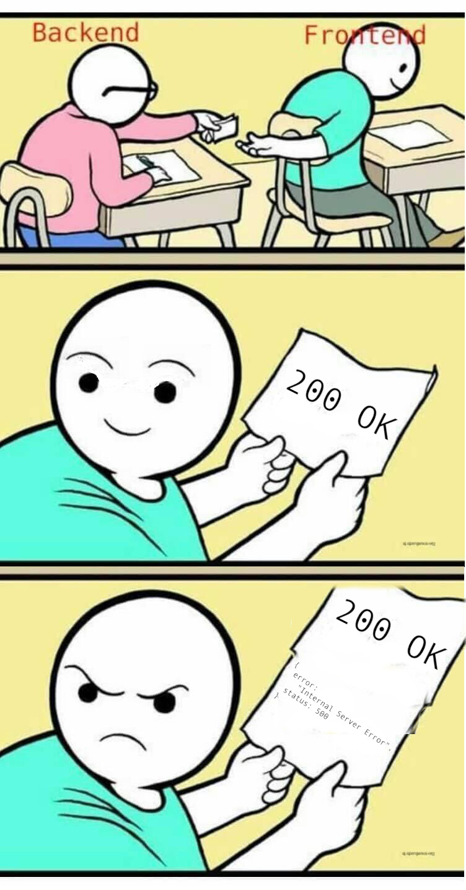

ICEBREAKER QUESTIONS
Can you use OpenAPI for GraphQL?
Tools for translation:
https://github.com/graphql/graphql-playground
https://github.com/IBM/openapi-to-graphql
https://github.com/yarax/swagger-to-graphql
https://loopback.io/openapi-to-graphql.html
No.
Notes:
Let me start with an icebreaker question.
Can you use OpenAPI for GraphQL?
Well, the short answer is no.
GraphQL breaks REST standards.
GraphQL APIs are usually documented through the GraphQL server itself.
GraphQL and REST are competing technologies.
Hopefully, in the future the advantages and disadvantages of both will be better understood, and a more balanced view would be to use the better parts from each of them.
Here are a couple of tools you can use to translate an OpenAPI spec to a GraphQL spec document that I have come across, maybe you will find them useful.

Slide 58
QUESTIONS
Notes:
QUESTIONS

Slide 59




CONTACTS
Schwarz Global Services Bulgaria EOOD
We are hiring!
Office X, Floor 9, Schwarz IT, bulevard "Cherni vrah" 51, 1407 Promishlena zona Hladilnika, Sofia
https://dev.bg/company/schwarz-it/
https://it.schwarz/en/international/bulgaria
https://www.jobs.bg/company/schwarz-it
Notes:
If you liked what you saw and want to work with this and other cool tech we have,
please checkout our websites and talk to our HRs.

Slide 60
THANK YOU!
Notes:
THANK YOU!

Slide 62
{BONUS}
Notes:
Bonus

Slide 63
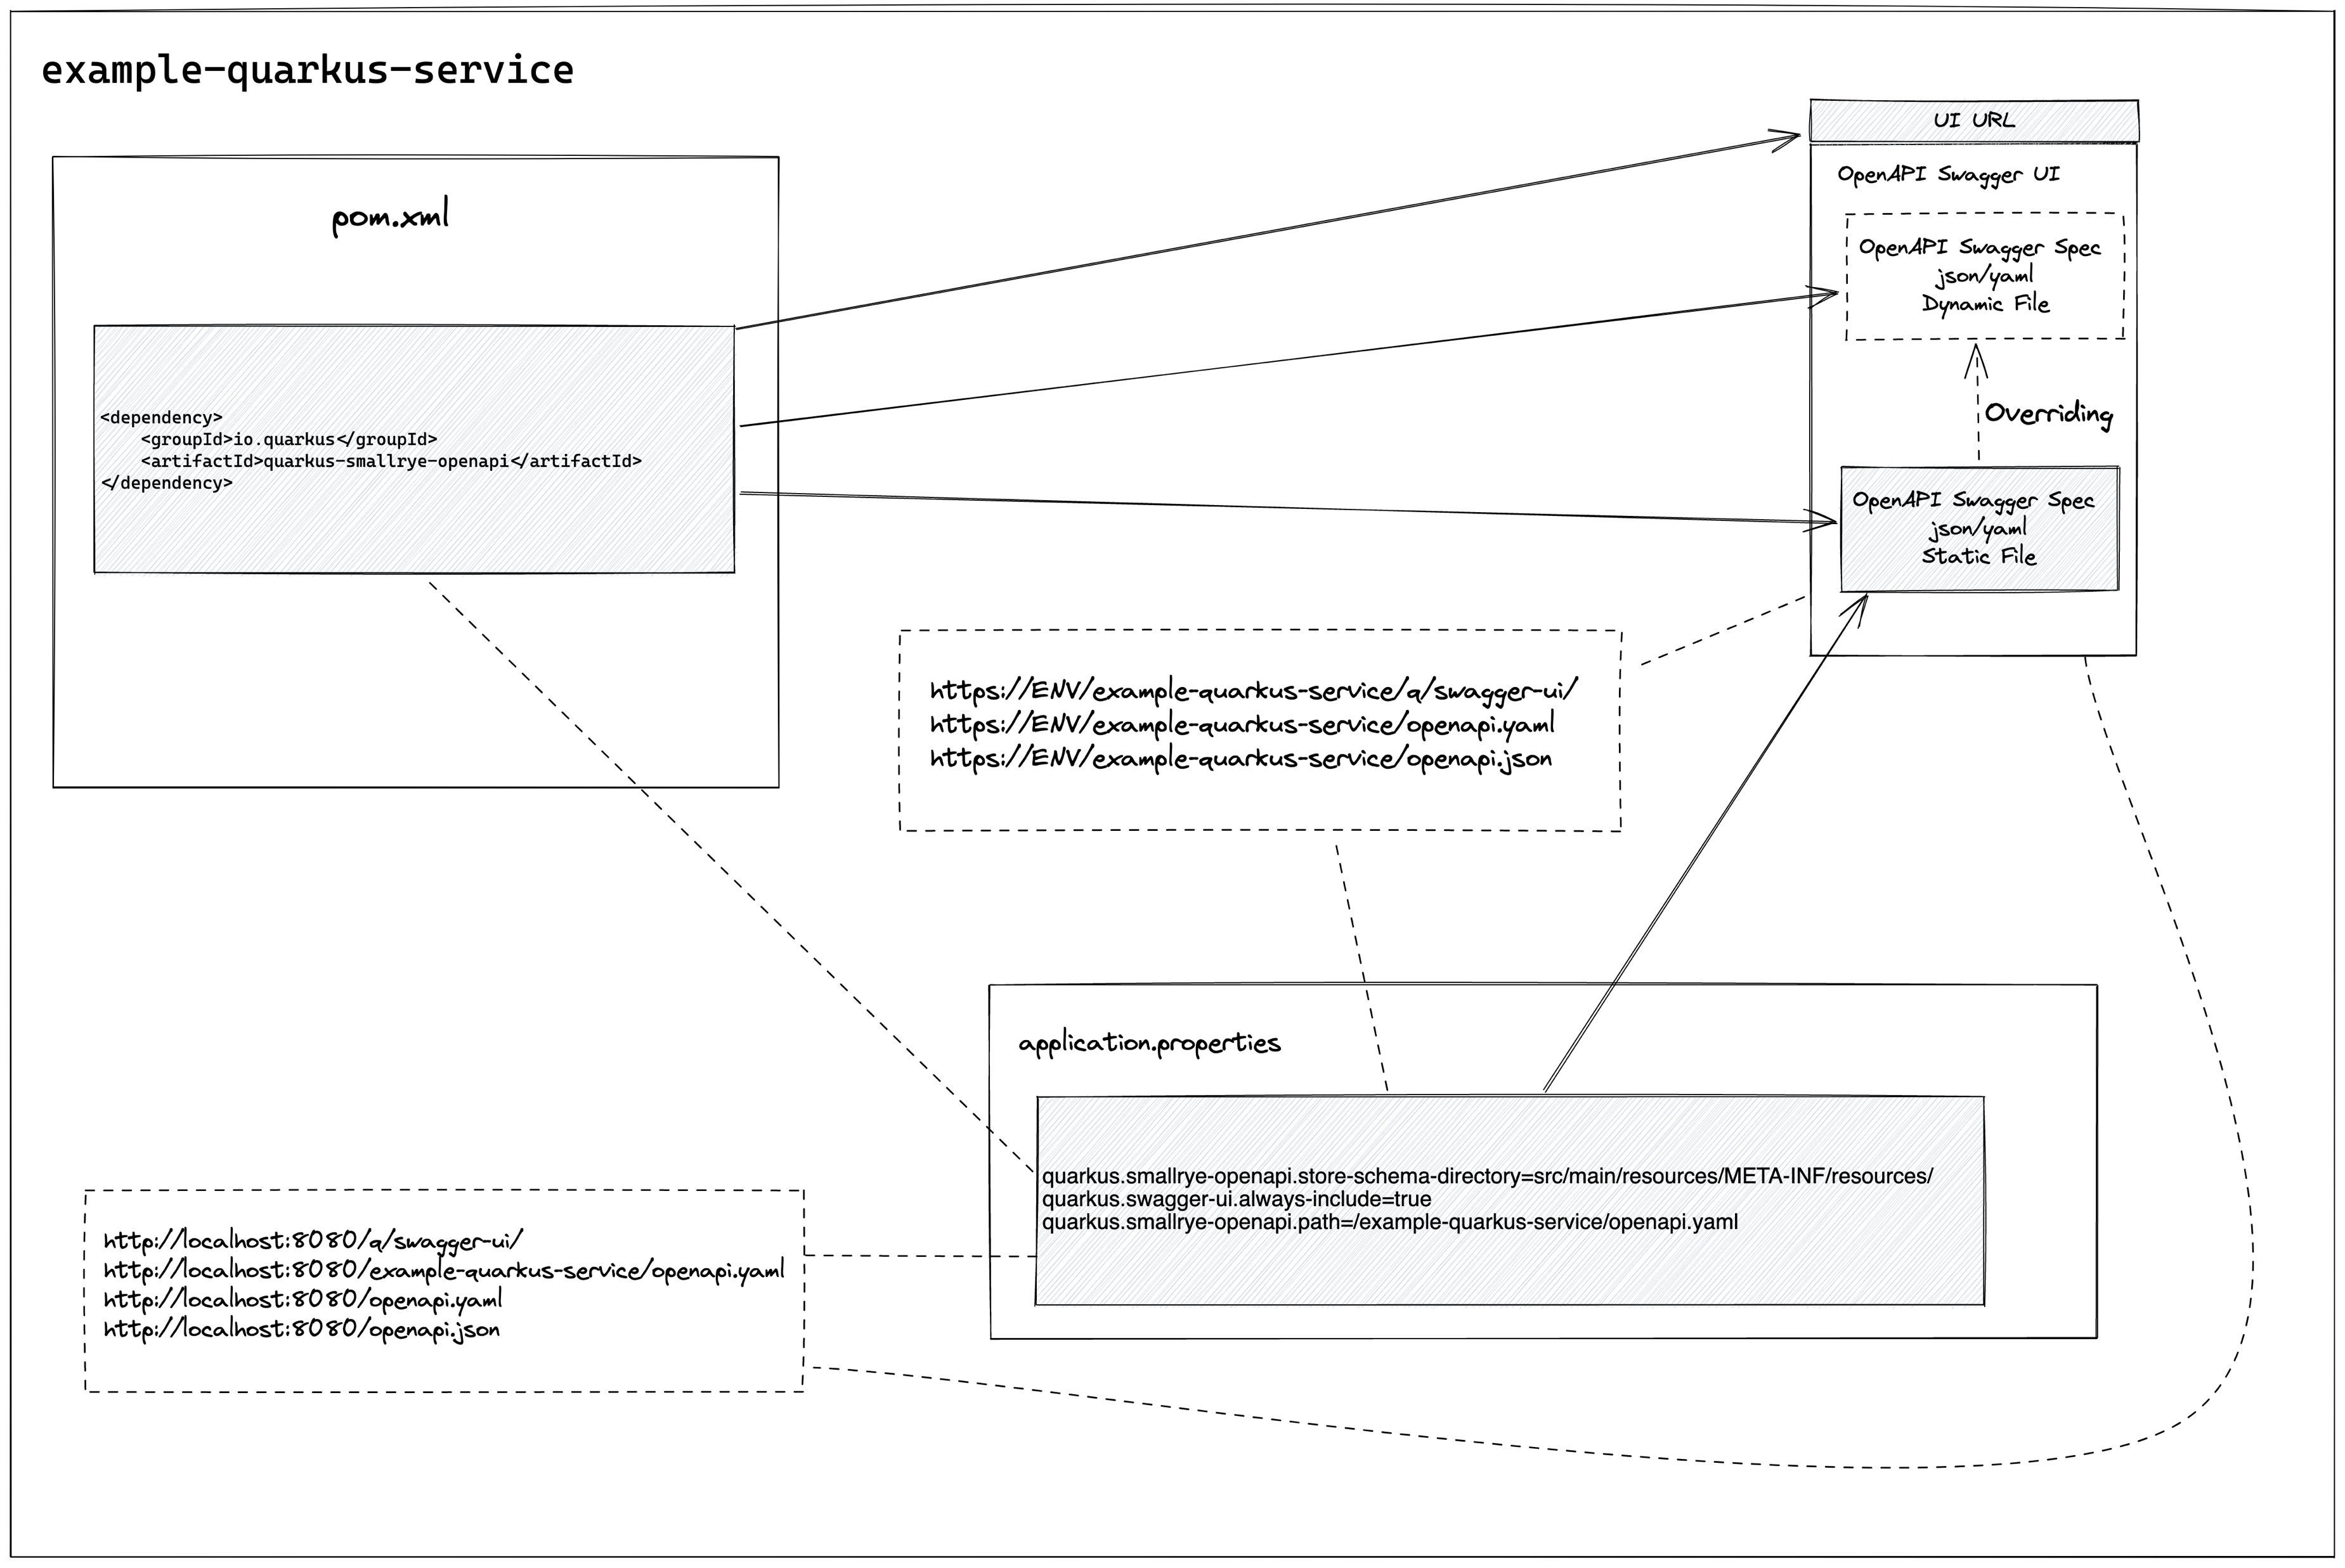
OPENAPI + QUARKUS
Notes:
OPENAPI + QUARKUS

Slide 64

WOLF FACT
It’s all in the howl
Wolves do howl at night, and these soulful calls have nothing to do with the moon. Their penetrating, hauntingly beautiful howl is a primary communication tool, both between lone wolves and their pack, as well as between packs.
Notes:
Random wolf fact.
It’s all in the howl
Wolves do howl at night, and these soulful calls have nothing to do with the moon. Their penetrating, hauntingly beautiful howl is a primary communication tool, both between lone wolves and their pack, as well as between packs.

Slide 65
THANK YOU!
Notes:
THANK YOU!

